Slide 1

DASHBOARD ON VIDEO GAME SALES ANALYSIS
BOARD INFINITY PROJECT
DONE BY:
M.GURUPRASAD REDDY

Slide 2

SUMMARY
INTRODUCTION AND SOURCE OF DATA
OBJECTIVE
RAW DATA AND SORTED DATA
PROBLEM STATEMENTS
STATEMENT SOLUTIONS
DASHBOARD
CONCLUSION

Slide 3

SOURCE OF DATA: VIDEO GAMES DATA
LINK FOR DATA
https://www.kaggle.com/rush4ratio/video-game-sales-with-ratings
Introduction to data:-
Name of the game.
Year of release.
Platform.
Genre.
Publisher.
Sales .
Rating by ESRB.
User-score.
Critic score.
Developer.
CALCULATED FIELDS
USER SCORE_FOR 100
USER RATING
TO CREATE DASHBOARD ON VIDEO GAME SALES AND FIND OUT TREND OF VIDEO GAME’S AND RESPONSE OF USER TO THOSE GAMES .
OBJECTIVE:

Slide 4
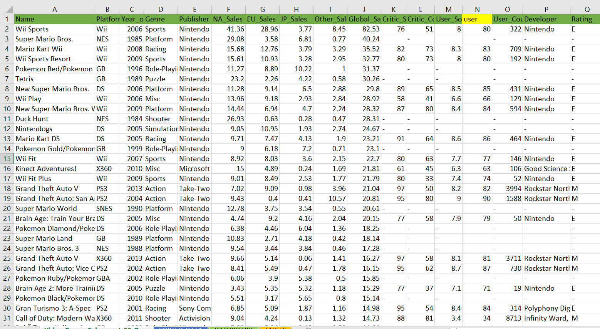
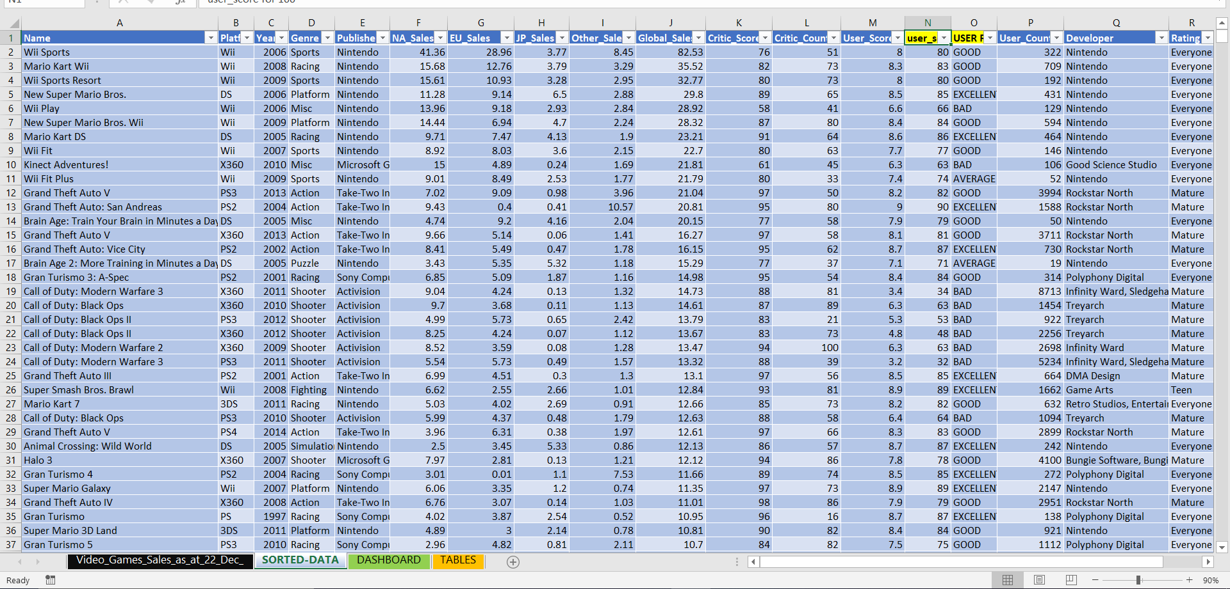
Raw data
Sorted data

Slide 5

Problem statements:
1.What is the overall sales of games in a particular year?
2.Number of games released in particular year ?
3.In which platform more number of games were released?
4.More number of games were released in which Genre?
5.who are the top 5 publishers?
6.What is the ESRB rating of the games?
7.What is the sales value every year in specific platform?
8.what is the user response to the games released in a year?
9.on overall which region has more sale ?
10.what is the trend of video games sales from 1985-2016?

Slide 6
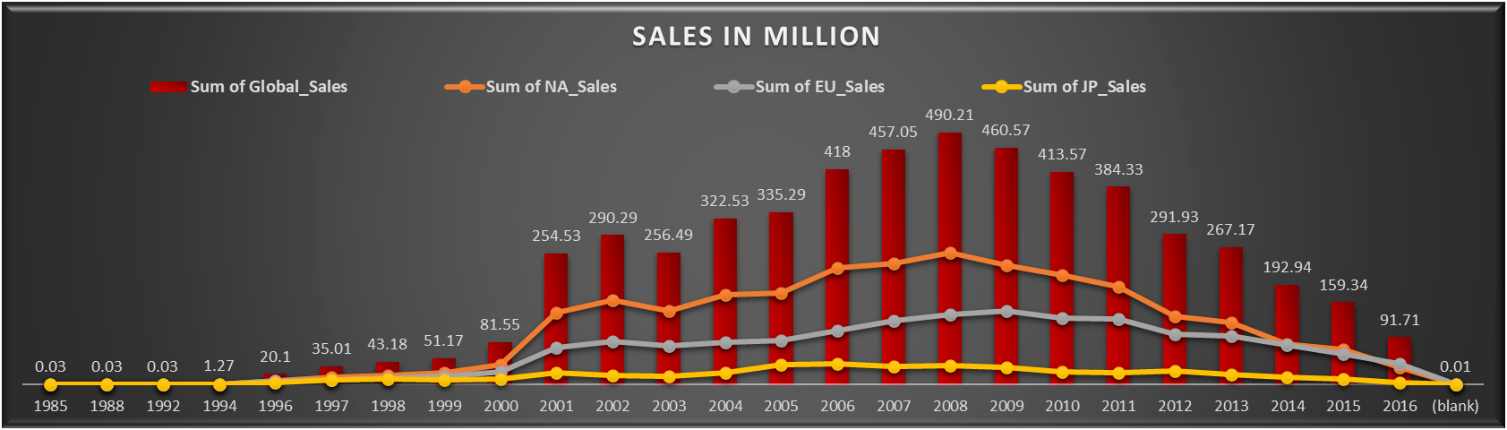

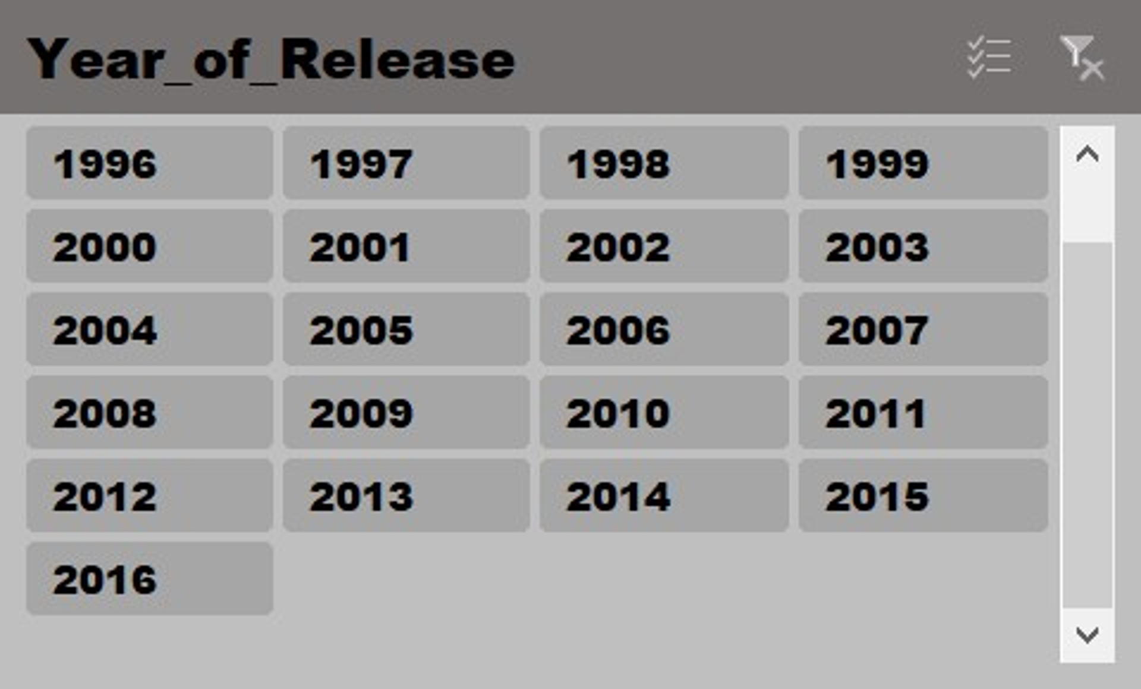
1.What is the overall sales of games in a particular year?
2.Number of games released in particular year ?

Slide 7
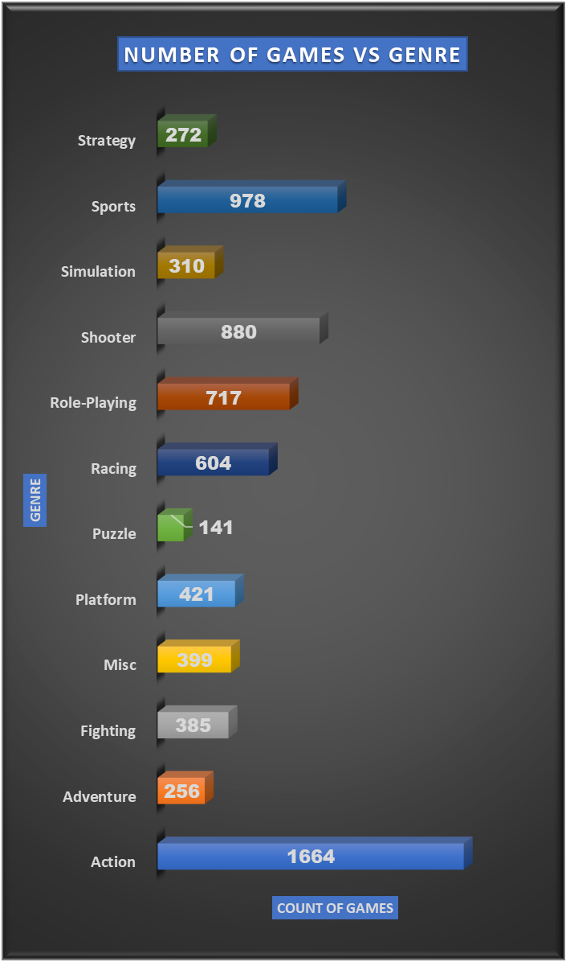
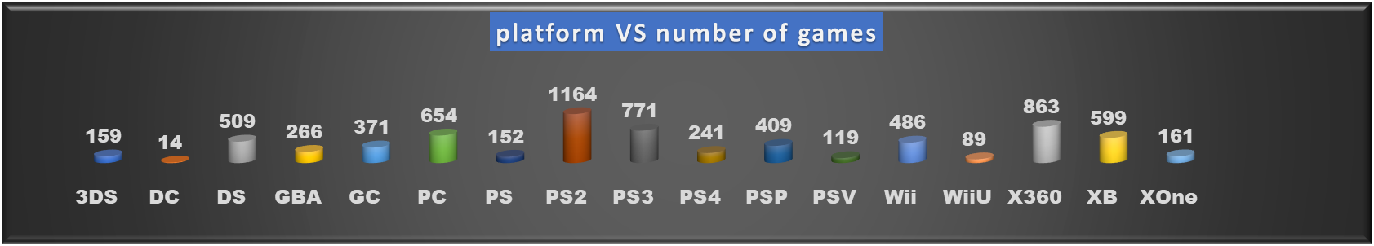
3.In which platform more number of games were released?
PS2
4.More number of games were released in which Genre?

Slide 8
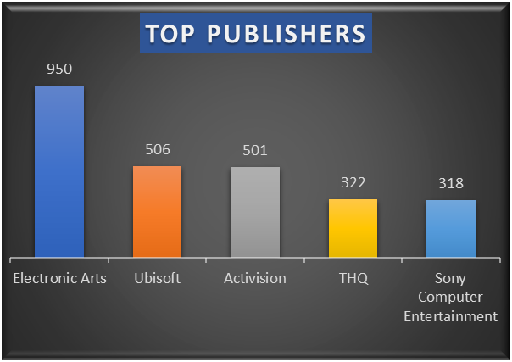
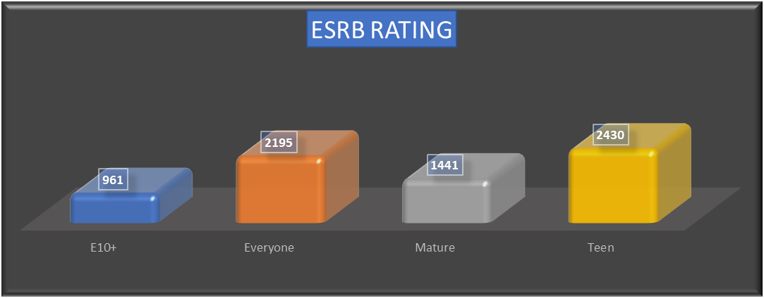
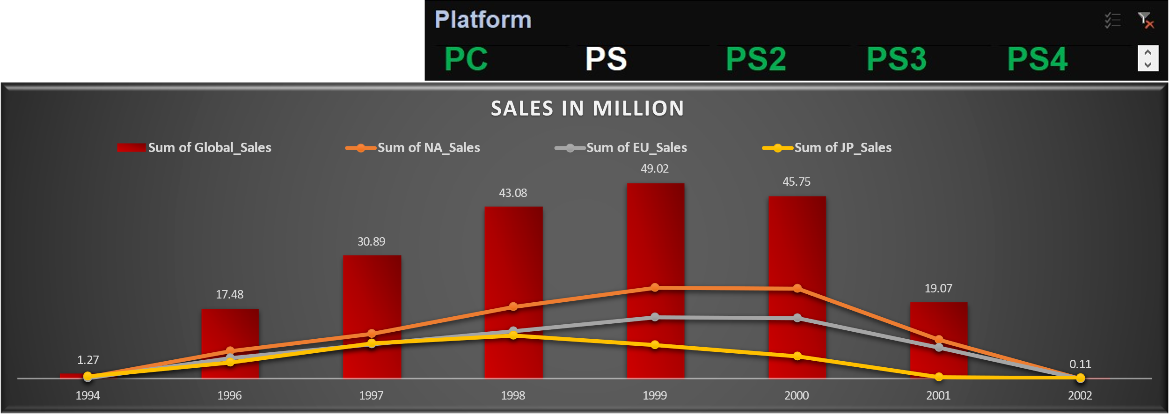
5.who are the top 5 publishers?
6.What is the ESRB rating of the games?
7.What is the sales value every year in specific platform?

Slide 9
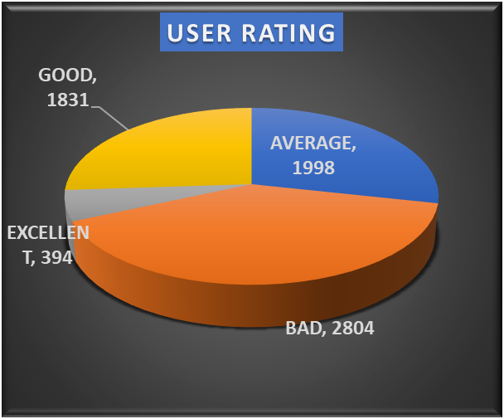
8.what is the user response to the games released in a year?
EXCELLENT-394
GOOD-1831
AVERAGE-1998
BAD-2804
9.on overall which region has more sale ?
10.what is the trend of video games sales from 1985-2016?

Slide 10
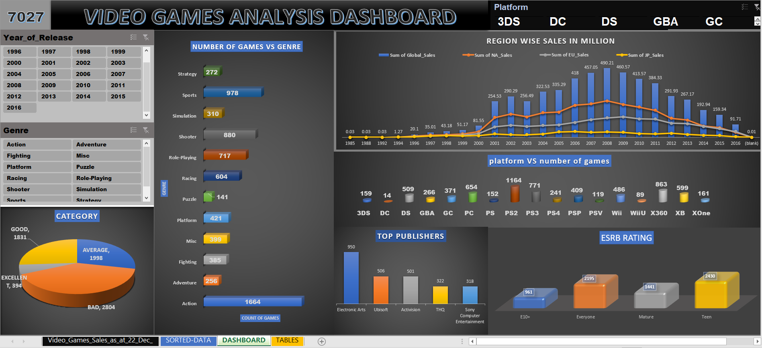

Slide 11
CONCLUSION
BY OBSERVING THE DASHBOARD WE CAN CONCLUDE THAT
In 1985 the sales of video games is very low but year by year the sales gradually starting increasing and in between 2007-2009 years the sales were recorded maximum and after that period the sales gradually decreased .
In every period of time north –America contributes approximately half of the global sales.
Most of the games were released in action genre.
Lot of games that were released got ESRB rating as teen and mature .

Slide 12


THANK YOU
CLICK HERE FOR PPT VIDEO
M.Guruprasad Reddy
CLICK HERE FOR EXCEL FILE
gpreddy2526@gmail.com
STAY SAFE

